Slide 1
ML-based and Hybrid Approaches that Deal with Severe Data Limitations
Nov 7, 2019

Slide 2
Summary
Most of basic and advances ML techniques have one main objective in common
How to handle data incompleteness (which is always there) and still create meaningful and stable models
Data incompleteness can be tackled on different levels of ML and hybrid frameworks:
The core ML algorithm (e.g. choice of parsimonious base models in boosting algorithm or layer-by-layer learning in deep learning)
Additional generic regularizations (e.g. L1 or L2 regularization in DNN or additional filters / rules of selecting models at boosting iterations)
Discovery of robust representations with dimensionality reduction relevant to the problem (e.g. using unsupervised / semi-supervised auto-encoders or other types of feature engineering).
Usage of existing domain knowledge for model inputs selection, domain-specific constraints, generation of synthetic data to augment available training data and/or employment of domain-specific models as base models in boosting
However, in situations of severe data limitation, including cases where just one or a few training samples are available, the described approaches will be useless and special methods are required including the following:
Transfer Learning
One-shot or few-shot learning using Representation by Similarity
One-shot or few-shot learning using Ensemble Decomposition Learning (EDL)
Few-shot learning using Model-Agnostic Meta-Learning (MAML)
Other approaches including Meta-Transfer Learning

Slide 3
Transfer Learning
Transfer learning is applicable when you can find different problem that is related to the problem of interest but which has large number of training samples and often already pre-trained ML model:
Get pre-trained model (e.g. DNN)
Use data set of interest (which is small) to fine-tune the pre-trained model by fixing weights for majority of first layers and adjusting only a few final layers.
The number of fixed layers is determined by the relevance of the two problems – less relevance would require more layers to be adjusted.
When data set is very small, supervised classification part could be replaced by even simpler model (e.g. GLM)

Slide 4
One-Shot (Single-Example) Learning using Representation by Similarity

Slide 6
One-Shot (Single-Example) Learning using Ensemble Decomposition Learning

Slide 7
One-Shot (Single-Example) Learning using Ensemble Decomposition Learning

Slide 8
One-Shot (Single-Example) Learning using Ensemble Decomposition Learning

Slide 9
One-Shot (Single-Example) Learning using Ensemble Decomposition Learning

Slide 10
One-Shot (Single-Example) Learning using Ensemble Decomposition Learning

Slide 11
Few-Shot Learning using Model-Agnostic Meta-Learning (MAML)
By pre-training on multiple tasks, MAML tries to find internal NN representation that is very sensitive to a single or few iteration updates when new data is presented.
This feature facilitates to find reasonable solution when just a few data points from a set of interest are available given that problem is relevant to those used in pre-training phase.

Slide 12
Few-Shot Learning using Model-Agnostic Meta-Learning (MAML)

Slide 13
Few-Shot Learning using Model-Agnostic Meta-Transfer Learning (MTL)
MAML approach could be effective when significant number of relevant problems with a few samples are available.
However, by design, MAML can only work with simple enough (shallow) NNs. DNNs typically used in standard transfer learning cannot be used because only a few data samples are available for each reference problem.
Meta-Transfer Learning (MTL) is introduced to allow DNN usage with meta learning.
The key ideas of MTL can be summarized as follows:
Weights of feature selection part of the reference DNN kept intact (to avoid “catastrophic forgetting” problem). Instead weight scaling and bias shifts are applied, which significantly reduces number of adjustable parameters.
For further enhancement of MTL algorithm robustness, sampling of meta-learning tasks is not random – the sampling scheme, called “hard task meta-batch”, gives preference to hard-to-learn classes.

Slide 14
Few-Shot Learning using Model-Agnostic Meta-Transfer Learning (MTL): Algorithm Summary
Step 1: Train DNN on large-scale data (both feature extractor and classifier)
Step 2: Keep feature extractor weights intact and optimize classifier weights for a sampled task on the corresponding training set. Classifier weights from large-scale training are discarded here.
Step 3: Optimize scale-and-shift parameters applied to feature extractor weights using corresponding test set
Step 4: Update meta-learning weights of the classifier using test set

Slide 15
Few-Shot Learning using Model-Agnostic Meta-Transfer Learning (MTL): Importance of Hard-Task Meta-Batch

Slide 16
Potential Fannie Applications: Emerging Fraud Patterns
Complementary approaches (case-based reasoning):
The described boosting-based feature vector can be used in case-based reasoning (CBR) capable to handle emerging types of fraud for which data is still very limited to build standard classifier.
In such cases one can choose a representative reference pool of fraud loans (could be large or small) and compute feature vectors for each of them. For each new loan, one also computes feature vector and computes its distance to all loans from the reference pool. Although such distance could be based on direct Euclidean metrics, one can use ranking distance (Kendall tau distance) to get much more stable results.
New loans can be ranked using such a distance to reference pool.
Very preliminary illustration is given in the next slide.

Slide 17
Potential Fannie Applications: Emerging Fraud Patterns

Slide 18
Potential Fannie Applications: Generic Framework for Building Loan-Performance models for sub-populations with small number of loans
Population size of delinquent / default / prepay loans is often small in loan performance data sets for a given period of interest.
Situations where performance of core loan performance model significantly deteriorates for certain sub-populations (e.g. low FICO or high DTI new acquisitions, PIW loans etc) is often encountered.
In such cases, it is beneficial to have a separate model for these sub-population, however, data limitations is even more severe.
Few-shot learning techniques such as discussed here (i.e. NN-based meta-learning) can be useful in such cases. Here meta-learning tasks can be formulated as prepay / delinquency / default models (or even their combinations) applied to different loan-attribute buckets.
Discussed meta-learning techniques have being already used by us in a different form for boosting algorithms (e.g. pre-generation of base model sets using different objectives and data sets).
Presented meta-learning techniques can be reformulated for any other algorithms in terms of hyper-parameter optimization.
The generic framework with classical meta-learning and presented additional options for estimation of loan performance model for small sub-populations is currently being designed and will be implemented by ML Lab team.

Slide 19
EDL – beyond few-shot or zero-shot learning
EDL and original similarity representation can be used for one-shot or few-shot learning.
However, EDL can also be considered as fine-grain state representation that can be used in calculating distance metrics for clustering and similar analysis.
Clustering based on loan attributes could be very sensitive to deviation in certain attributes that actually have minimal effect on metrics of interest (e.g. prepay or delinquency probability).
On the other hand, usage of aggregated model outputs (e.g. prepay or delinquency probability) would not capture more subtle differences.
EDL-based distance could be used for such fine-grain differentiation.

Slide 20
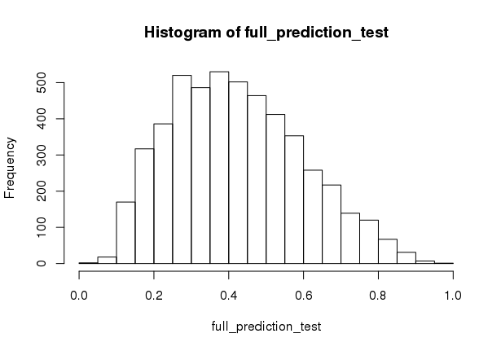
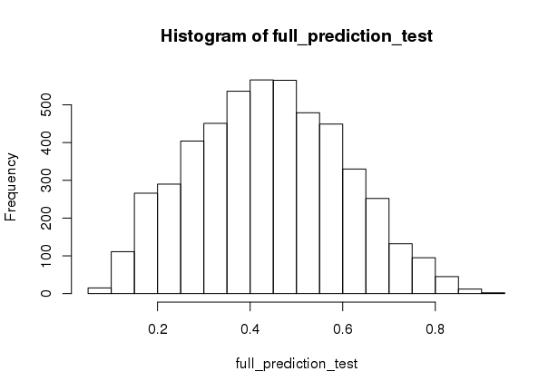
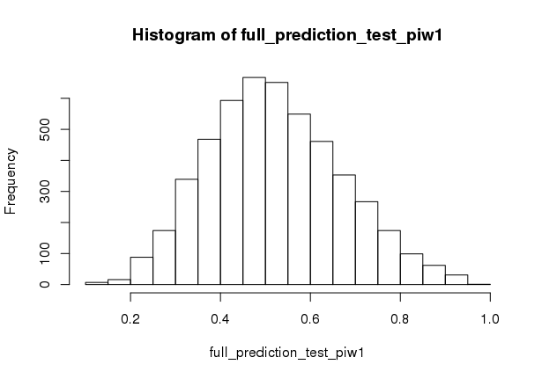
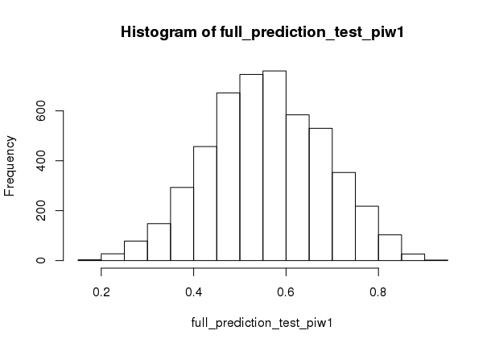
PP6 model score for non-PIW population
PP6 model score for non-PIW population
PIW Example
PP6 model score for PIW population
PP6 model score for PIW population
with SATO
without SATO

Slide 21
PIW Example

Slide 22
PIW Example
with SATO
without SATO

Slide 23
ACI Data Example

Slide 24
ACI Data Example

Slide 25
ACI Data Example

Slide 26
ACI Data Example

Slide 27
Zero-Shot Learning (ZSL)
Go there - I do not know where
and bring me that - I do not know what
--- from Russian fairytale

Slide 28
Zero-Shot Learning (ZSL) via Semantic Embedding
Attribute Embedding (binary or continuous)

Slide 29
Zero-Shot Learning (ZSL) via Semantic Embedding
Word Embedding (e.g. Word2Vec)

Slide 30
Zero-Shot Learning (ZSL) via Semantic Embedding
Word Embedding (collecting rich descriptions)

Slide 31
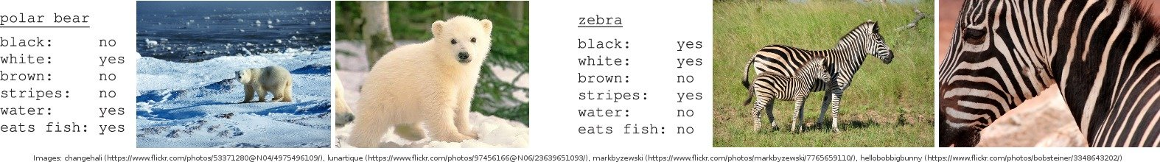
Zero-Shot Learning (ZSL) via Semantic Embedding
Data Sets, e.g. Animal with Attributes (AwA and AwA2)

Slide 32
Zero-Shot Learning using Synthesized Classifiers

Slide 33
Zero-Shot Learning using Synthesized Classifiers

Slide 34
Zero-Shot Learning using Synthesized Classifiers

Slide 35
Zero-Shot Learning using Synthesized Classifiers

Slide 36
Weighted Graph Embedding into m-dimensional Euclidean Space: Laplacian Eigenmaps

Slide 37
Zero-Shot Learning using Synthesized Classifiers: Learning phantom classes

